Slide 1
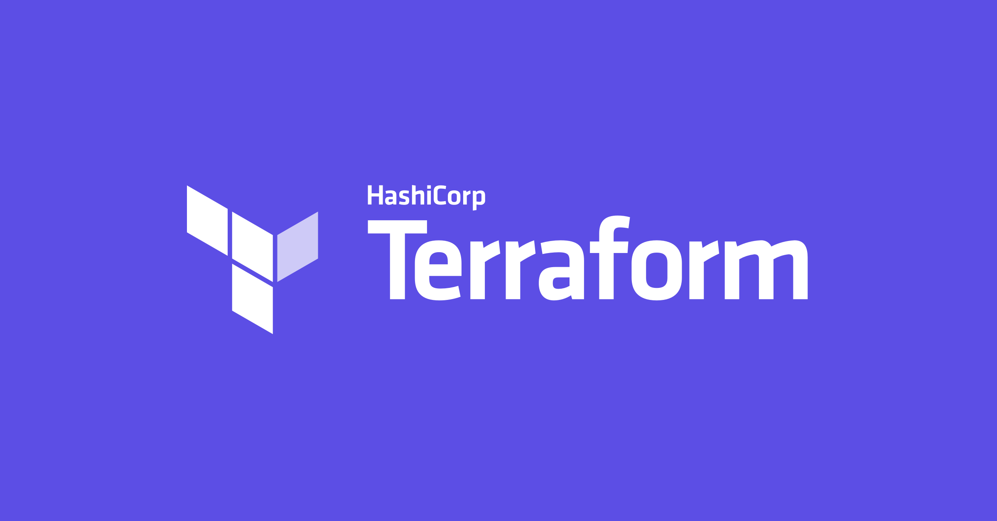
In simple words

Slide 2


Agenda
The Problem
About Terraform
Comparing to other tools
Features
Get Started
Configuration examples
Internals
Good Practices
Alex Shpak alexander.shpak@softwerk.se

Slide 3
The Problem

Slide 4
The Problem
Humans are not reliable ¯\_(ツ)_/¯
We want infrastructure reproducible
Automate all things!
Also we want versioning, code reviews and collaboration
And what if you need to recreate you infrastructure?

Slide 5
Terraform
HashiCorp
“HashiCorp Terraform enables you to safely and predictably create, change, and improve infrastructure. It is an open source tool that codifies APIs into declarative configuration files that can be shared amongst team members, treated as code, edited, reviewed, and versioned.”
https://terraform.io
HashiCorp is the company that stands behind Terraform, they also brought to us well known tools like Consul, Vagrant and Nomad
https://hashicorp.com

Slide 6
Comparing to other tools
It is might be not correct to compare Terraform to some other tools listed because they have different purposes, but I want to show practical difference.
 | Orchestration |  | Provisioning
 | Terraform | CloudFormation | Ansible | Chef | SaltStack
Configuration | Declarative | Declarative | Procedural | Procedural | Procedural
Syntax | HCL | JSON | YAML | Ruby | YAML
Vendors | Multiple | AWS Only | Multiple | Multiple | Multiple
Architecture | Client | Client | Client | Client/Server | Client/Server

Slide 7
Features
Source Code
Links
Infrastructure as Code
Plan and review execution
Use multiple clouds same time
3rd party cloud providers as well
Plug-in system
Import existing infrastructure
Provisioning
Open Source
Under Mozilla Public License 2.0
Github
Official website
Providers Documentation
Providers Registry

Slide 8

Let’s Get Started

Slide 9

Installation
Terraform is written in Go and distributed as binary without external dependencies.
Download here: https://www.terraform.io/downloads.html
Instructions are also there, just put it into your binary path, or use one of package managers like brew.
Builds are available for Linux, MacOS, FreeBSD, Solaris and Windows

Slide 10
Terraform CLI
Usage: terraform [-version] [-help] <command> [args]
Common commands:
apply Builds or changes infrastructure
console Interactive console for Terraform interpolations
destroy Destroy Terraform-managed infrastructure
env Workspace management
fmt Rewrites config files to canonical format
get Download and install modules for the configuration
graph Create a visual graph of Terraform resources
import Import existing infrastructure into Terraform
init Initialize a Terraform working directory
output Read an output from a state file
plan Generate and show an execution plan
providers Prints a tree of the providers used in the configuration
push Upload this Terraform module to Atlas to run
refresh Update local state file against real resources
show Inspect Terraform state or plan
taint Manually mark a resource for recreation
untaint Manually unmark a resource as tainted
validate Validates the Terraform files
version Prints the Terraform version
workspace Workspace management

Slide 11
Terraform CLI
terraform init To download and install providers and initialize modules
terraform apply To refresh state, create and execute plan, and print outputs
terraform destroy Destroy managed resources and clean state

Slide 12
HCL (HashiCorp Configuration Language)
Configuration language from HashiCorp that is translatable to JSON. Read more here: https://github.com/hashicorp/hcl
Human and machine readable
Supports comments
Decreases size and nesting
resource "digitalocean_droplet" "vxodev" {
image = "centos-7-x64"
name = "my-droplet"
region = "ams3"
size = "s-1vcpu-1gb"
}
{
"resource": {
"digitalocean_droplet": {
"example": {
"image": "centos-7-x64",
"name": "my-droplet",
"region": "ams3",
"size": "s-1vcpu-1gb"
}
}
}
}

Slide 13
Tiny working example
provider "digitalocean" {
token = "${var.api_token}"
}
resource "digitalocean_droplet" "vxodev" {
image = "centos-7-x64"
name = "my-droplet"
region = "ams3"
size = "s-1vcpu-1gb"
}
variable "api_token" {
description = "DigitalOcean Read/Write API token"
}

Slide 14
Folder structure
├── .terraform <- This what init command creates
│ └── plugins
│ └── darwin_amd64
│ ├── lock.json
│ └── terraform-provider-digitalocean_v1.0.2_x4
├── main.tf <- Terraform configuration file (HCL)
├── other.tf
├── network.tf
└── terraform.tfvars <- Assigned variables
Terraform reads all *.tf files in current folder, and it doesn’t read nested folders. Also file names and order doesn’t matter.
Terraform creates a graph with all resources defined and executes them in proper order to satisfy dependencies.

Slide 15
Add few more things
output "ip" {
value =
"${digitalocean_droplet.example.ipv4_address}"
}
data "digitalocean_ssh_key" "default" {
name = "Default Key"
}
module "extra" {
source = "path/to/module"
input = "value"
}
resource "digitalocean_droplet" "vxodev" {
...
provisioner "remote-exec" {
inline = [
"yum -y install docker"
]
}
}

Slide 16
Terraform State

Slide 17
Terraform State
Terraform state is JSON representation of how terraform sees your infrastructure.
State is used by Terraform to map real world resources to your configuration and keep track of metadata.
Each time when you run terraform apply, terraform will refresh knowledge about your infrastructure and configuration and compare it to current saved state, proposing changes if needed.
State file is really important file and should be backed up and stored securely.
State file might, and most likely will, contain sensitive information.
If you lose state file - you lose mapping between configuration and real world resources.
State file is promised to be backward compatible across terraform versions.

Slide 18
Securing Terraform State
Encrypt configuration repository
Alternatively encrypt sensitive files and *.tfstate files, for example with git-crypt
Use protected branches or other access control to you repository
Add variables and sensitive information in CI (with environment variables for example)
Terraform supports storing state in remote backend.
State locking is useful when more than one person is working on infrastructure.
Provider | Locking
consul | Supported
etcdv3 | Supported
gcs | Supported
http | Via REST
s3 | via DynamoDB

Slide 19
Good Practices
And things I wanted somebody to tell me before I started with terraform

Slide 20
Good practices
Separate state for your environments
Make your infrastructure parts disposable
Use modules from start
Control resource lifecycle, mark your data resources to not be destroyed
Review proposed changes, few times
Run Terraform in CI
Terraform tend to destroy resources
Importing resources or restoring state is hard
Use filename convention ├── main.tf ├── outputs.tf ├── providers.tf ├── terraform.tfvars └── variables.tf

Slide 21
Questions time!

